Slide 1
Wired, Optical and Wireless Communications
Michael J. Miller
College of Engineering and Information Sciences
NETW310 : Wired, Optical and Wireless Communications with Lab
Dr. Messaoud Laddada
June 24, 2023

Slide 2
Introduction
In this course we covered electronic communication principles and communication transmission media including wired, optical, and wireless.
Table of Contents:
Baseband Signals and AM/FM Signals
Pulse Code Modulation (PCM) and Line Codes
Cables and Structured Cabling
Antenna Gain and Free Space Path Loss
Bit Error Rate of Fading Channels

Slide 3
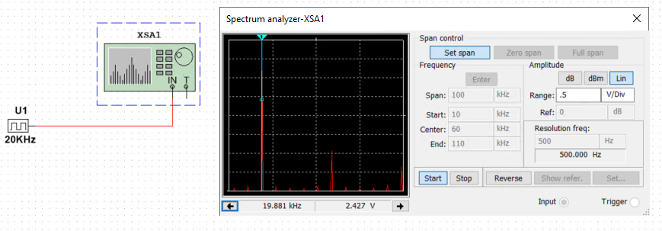
Baseband Signals and AM/FM Signals
Baseband Signals
Baseband signal - the original information signal to be transmitted, whether analog or digital.
Harmonic – “a sine wave whose frequency is some integer multiple of the fundamental sine wave” (Frenzel, 2015, p. 78)
The image below shows the spectrum analyzer displaying the signal’s harmonic spectrum and its panel settings. The signal voltage at each of the frequencies is recorded in the table to the right.
Harmonic Frequency | Signal (Volts)
20 kHz | 2.427 V
40 kHz | 0 V
60 kHz | 868.903 mV
80 kHz | 0 V
100 kHz | 575.737 mV

Slide 4
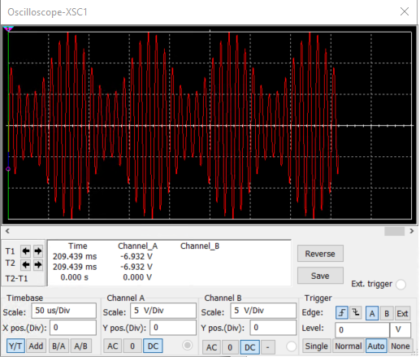
Baseband Signals and AM/FM Signals
AM Signals
Modulation – The process of impressing the baseband signal onto a higher frequency signal called the carrier signal.
AM (Amplitude Modulation) – The carrier frequency’s amplitude is modulated by the baseband or modulating signal
The screenshot of the Oscilloscope displays the waveform of an AM signal with a carrier frequency of 100 KHz and a baseband frequency of 10 KHz.

Slide 5
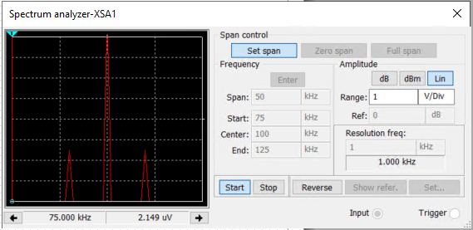
Baseband Signals and AM/FM Signals
AM Signals Cont.
Sidebands – When a carrier wave is modulated two additional signals are created. These sidebands occur above and below the carrier frequency at +/- the frequency of the baseband signal.
Frequency-domain – A plot of a signal’s amplitude in relation to the frequency.
The Spectrum Analyzer is displaying the frequency-domain of the AM signal from the previous slide. The table shows the measured sideband and carrier frequencies.
AM Modulation | Frequency (kHz)
Lower side band | 90.035 kHz
Carrier | 100 kHz
Upper side band | 109.965 kHz

Slide 6
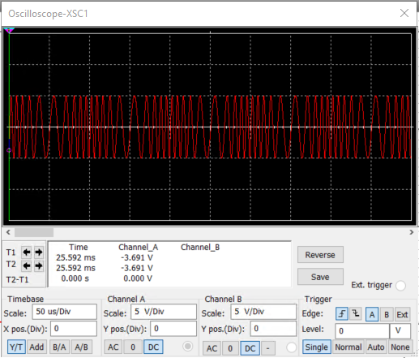
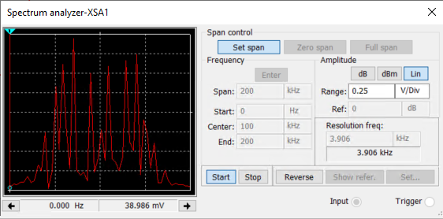
Baseband Signals and AM/FM Signals
FM Signals
FM (Frequency Modulation) – The carriers signals frequency is modified by the baseband signal.
The Oscilloscope (right) the time-domain display of an FM signal with a carrier frequency of 100 KHz and a baseband frequency of 10 KHz.
The Spectrum Analyzer (below) displays the frequency-domain of the FM signal.

Slide 7
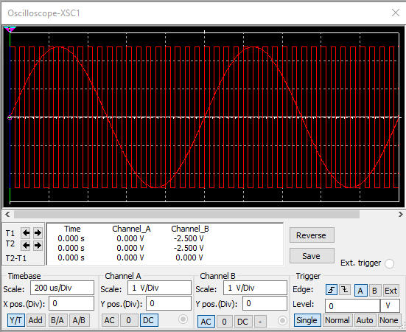
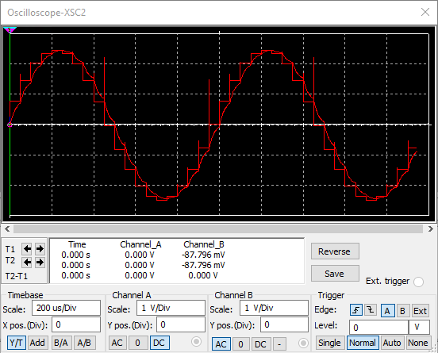
Pulse Code Modulation (PCM) and Line Codes
Pulse Code Modulation (PCM)
PCM (Pulse Code Modulation) – The process of converting an analog signal into a digital signal for transmission.
A/D Converter – Analog to digital converter
D/A Converter – Digital to analog converter
Display of an analog input signal of 1 KHz and sampling clock at 20 KHz.
Display of the output of the D/A converter.

Slide 8
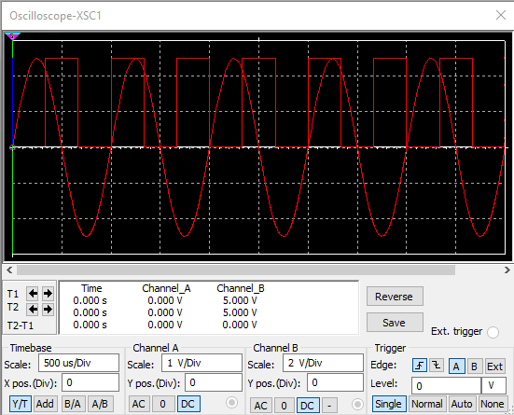
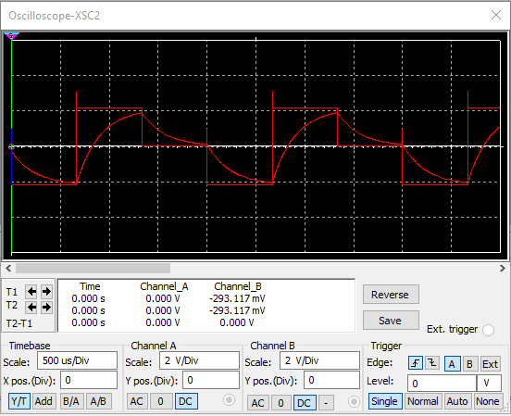
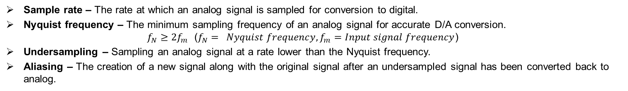
Pulse Code Modulation (PCM) and Line Codes
Pulse Code Modulation (PCM) Cont.
Sample rate – The rate at which an analog signal is sampled for conversion to digital.
Nyquist frequency – The minimum sampling frequency of an analog signal for accurate D/A conversion. $f_{N}≥{2f}_{m}$ ($f_{N}= Nyquist frequency, f_{m}=Input signal frequency$)
Undersampling – Sampling an analog signal at a rate lower than the Nyquist frequency.
Aliasing – The creation of a new signal along with the original signal after an undersampled signal has been converted back to analog.
Oscilloscope display with the analog input signal of 1 KHz and sampling clock at 1.5 KHz.
Display of the signal output after D/A conversion of an undersampled signal

Slide 9
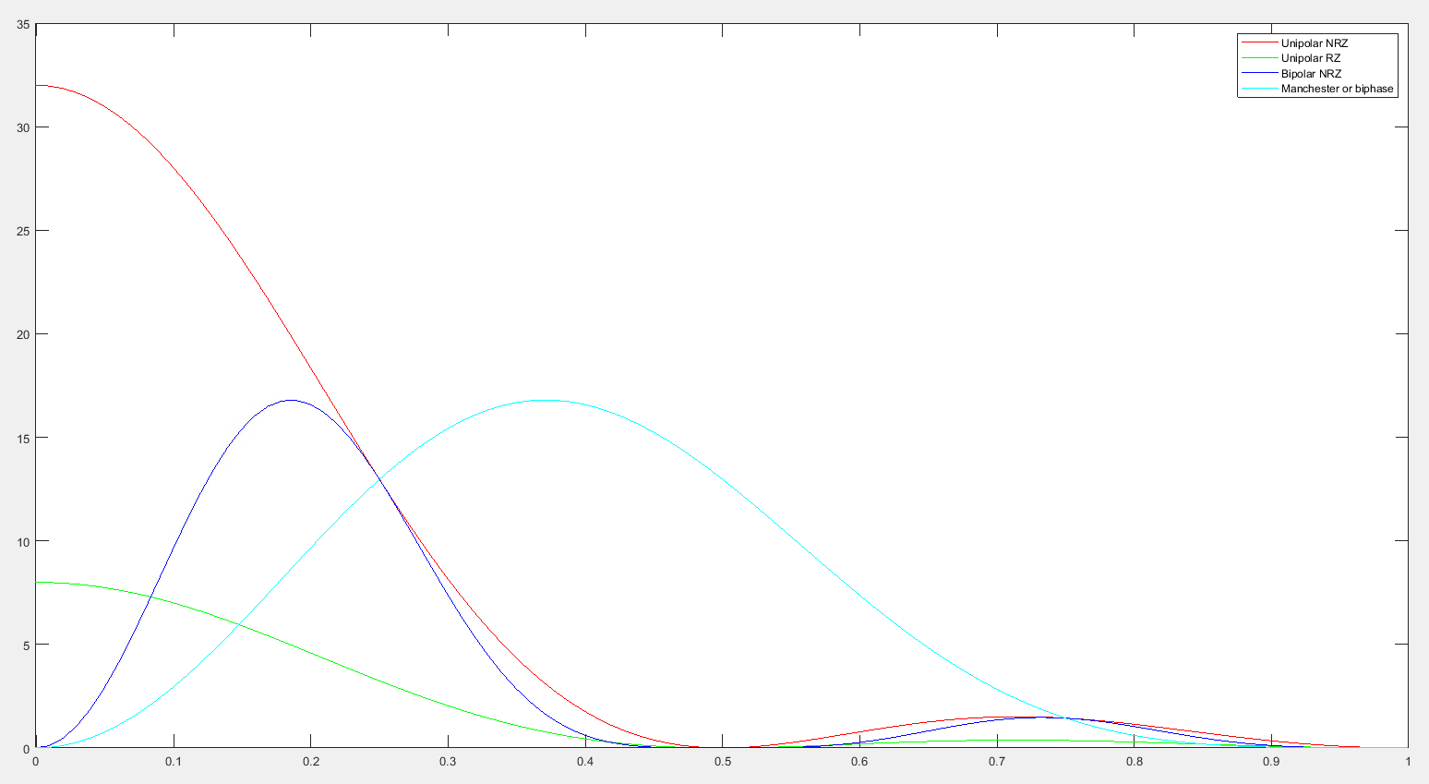
Pulse Code Modulation (PCM) and Line Codes
Line Codes
This screenshot shows the power spectral densities of four-line codes: NRZ-Polar, NRZ-Unipolar, NRZ-Bipolar, and Manchester-Polar.
When comparing the NRZ-Bipolar and Manchester polar codes in the diagram the Manchester-Polar would require more bandwidth.

Slide 10
Questions
Cables and Structured Cabling
1. Why must the twisting in the individual wires be maintained in a UTP cable?
Answer: Unshielded Twisted Pair (UTP) cable contains from 2 to 1800 unshielded twisted pair cables. Normally shielding is used to prevent noise and electrical interference. Without the shield the only thing to reduce these effects is that the pairs of wire are twisted together. (Fosco Connect, n.d)
2. How many inches should UTP cable be separated from 110 volts electrical cable?
Answer: I couldn’t find any specific reference to the distances required. The best I could come up with were some forum answers, but the distance ranged from 2 to 5 inches.
3. Horizontal cabling connects what areas to each other?
Answer: “The horizontal cabling system extends from the work area telecommunications information outlet to the telecommunications room” (ANSI/TIA/EIA-568-B standards reference guide)

Slide 11
Cables and Structured Cabling
Questions
4. What is a plenum rated cable?
Answer: Plenum rated cable is cable that is rated to be used within plenum spaces. Plenum spaces are the space below raised floors and dropped ceilings and is used for air handling and HVAC within a building. These spaces are subject to higher temperatures and oxygen levels, and the cables are designed to reduce fire hazard and to not emit toxic gasses when burned. (Smartech Cables, 2023)
5. What is a riser tube used for?
Answer: A riser tube is used to run cable between floors in a building. (Niswander, 2019)
6. Is the grounding of equipment mostly a safety or a performance concern?
Answer: In my opinion, grounding is mostly a safety concern. Without proper grounding electrical equipment has no safe path to discharge stray electricity in case of a short or equipment failure. That being said, a good ground is essential for proper measurement of any data or modulated signal. The ground provides a stable baseline making measurements of amplitude consistent when creating, modulating and demodulating. In short, it’s necessary for both purposes.

Slide 12
Antenna Gain and Free Space Path Loss
Antenna Gain
1. What is the maximum theoretical antenna gain of a common dish antenna at the 2.4 GHz band? [4 points]
Answer: 22.379 dB
2. What is the maximum theoretical antenna gain of a common dish antenna at the 5 GHz band? [4 points]
Answer: 29.079 dB
3. Given the same sized reflector, which signals, high-frequency, or low-frequency, can be more efficiently focused by a common dish antenna (i.e., result in a higher antenna gain)? [5 points]
Answer: Higher frequencies can be more efficiently focused by a common dish antenna.
4. What is the maximum theoretical antenna gain of the dish antenna used in the VLA radio telescopes in New Mexico at the 5 GHz band? [4 points]
Answer: 63.059 dB
5. Given the same signal frequency, which dish antennas, large-sized or small-sized, are more efficient at focusing the signal (i.e., result in a higher antenna gain)? [5 points]
Answer: Larger sized antennas are more efficient at focusing a signal.

Slide 13
Antenna Gain and Free Space Path Loss
Free Space Path Loss
What is the free space path loss in dB at the 2.4 GHz band? [4 points]
Answer: -80.4 dB
2. What is the free space path loss in dB at the 5 GHz band? [4 points]
Answer: -87.2 dB
3. How does the free space path loss at a higher frequency (e.g., the 5 GHz band) compare with that at a lower frequency (e.g., the 2.4 GHz band)? [5 points]
Answer: There is more FSPL in higher frequencies.
4. What is the free space path loss in dB over 20 meters at the 2.4 GHz band? [4 points]
Answer: -66.421 dB
5. What is the free space path loss in dB over 40 meters at the 2.4 GHz band? [4 points]
Answer: -72.441 dB
6. What is the free space path loss in dB over 80 meters at the 2.4 GHz band? [4 points]
Answer: -78.462 dB
7. When the distance doubles, how does free space path loss in dB change approximately? [5 points]
Answer: A doubling of the distance results in approximately -6 dB loss.

Slide 14

Antenna Gain and Free Space Path Loss
Free Space Path Loss Cont.
8. Use a scientific calculator to calculate Delta $L_{fS}$ for D1 = 20 meters and D2 = 40 meters. [4 points]
Delta $L_{fS }$= -6.02 dB
9. Is your calculation approximately the same as the result from Part 2 Step 2? [4 points]
Answer: Yes

Slide 15
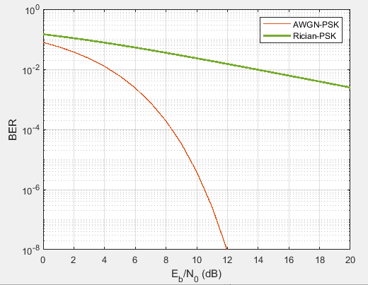
Bit Error Rate of Fading Channels
AWGN Channel and Rician Channel
This screenshot shows the bit rate error performance of both AWGN and Rician fading channels.

Slide 16
Bit Error Rate of Fading Channels
AWGN Channel and Rician Channel
Compare and contrast the BER performance of PSK over a noise limited (AWGN) transmission channel to the performance of PSK over a Rician channel at 5- and 10-dB Signal to Noise Ratio (E_{b}/N₀), respectively.
Is there a significant difference in BER performance of PSK between the AWGN channel and Rician channel?
Answer: At the lower SNR of 5-dB the difference between AWGN and Rician is measurable but nearly insignificant. On the other hand, at 10-dB SNR the difference is very significant. This would imply that whenever possible the AWGN channel (wired/copper medium) should be used.

Slide 17
Challenges
Understanding encoding used in serial transmission of data
Understanding frequency modulation and phase modulation

Slide 18
Career Skills Obtained
Deeper knowledge of communication techniques

Slide 19
Conclusion
In this course we covered electronic communication principles and communication transmission media including wired, optical, and wireless.
Table of Contents:
Baseband Signals and AM/FM Signals
Pulse Code Modulation (PCM) and Line Codes
Cables and Structured Cabling
Antenna Gain and Free Space Path Loss
Bit Error Rate of Fading Channels

Slide 20
References
ANSI/TIA/EIA-568-B standards reference guide, (n.d.) https://web.anixter.com/AXECOM/AXEDocLib.nsf/(UnID)/8F2E0839A6190F4986257309005757CC/%24file/ANSI-TIA-EIA-568-B.pdf
Fosco Connect, (n.d.), What is unshielded-twisted-pair (UTP) cable. http://www.fiberoptics4sale.com/wordpress/what-is-unshielded-twisted-pair-utp-cable/
Frenzel, L. (2015). Principles of Electronic Communication System (4th ed.). McGraw-Hill Learning Solutions. https://devry.vitalsource.com/books/1260901947
Niswander, T., (Sep. 19, 2019), What is Riser Cable?, https://infinity-cable-products.com/blogs/structure/what-is-riser-cablet
Smartech Cables, (2023), What is a plenum cable and where to use it? https://www.smartechcables.com/blog/what-is-plenum-cable/
Wikipedia contributors. (2023, May 29). Signal-to-noise ratio. From Wikipedia, The Free Encyclopedia. https://en.wikipedia.org/w/index.php?title=Signal-to-noise_ratio&oldid=1157539962

